Slide 1











㫫㫝㕑㨞㧢㩗㐁㖎㐇
㭎㐃㣃㔵㩗
1. 㧞
㯱 A 㰳㦸㭼㭎㙀 r −1 㜬㯽㦺㐿㪈㟬 .
( )
2. 㥧
㫫㫝㪒㘔㐂㯱
( )
3. 㥧 A 㝳㡨 , 㯱 ,
㤆㯣 㧂 A 㔻㑁㨜㝊㱅 .
( )
4. 㥧
㯱
㔻㱗㑓㪈 1 .
( )
䍤
䈻
㺖
5. 㧞 A, B, C 㪈 n 㜬㗉㱅㐂㥧 A B C = I㐂㯱
( )
6. 㧞 A 㪈 㝊㱅㐂r (A) = m㐂㯱㗛㤚㓄㫫㫝㗉㓌㰥
A X = b 㭎㔩㭼㝀 .
( )
䍤
䈻
㺖
7. 㥧 A, B 㪈 n 㜬㰓㔩㱅, 㯱
㭔㪈㰓㔩㱅 .
( )
8. 㥧 λ 㧂㰓㛆㝊㱅 A 㔻㩛㱩㯫㐂㯱 㭔㧂 A 㔻㩛㱩㯫 .
( )

Slide 2
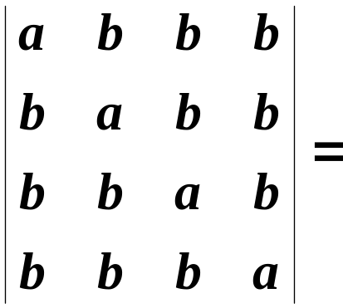
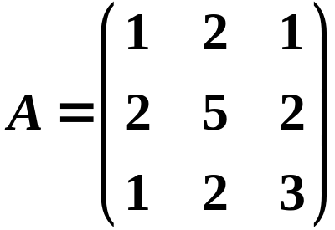

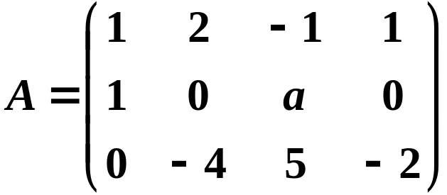


㖎㐃㩝㞁㩗
1.
㐆
䍤
䈻
㺖
2. 㧞 㐂㯱
㐆
3. 㧞 , 㯱
㐆
䍤
䈻
㺖

Slide 3
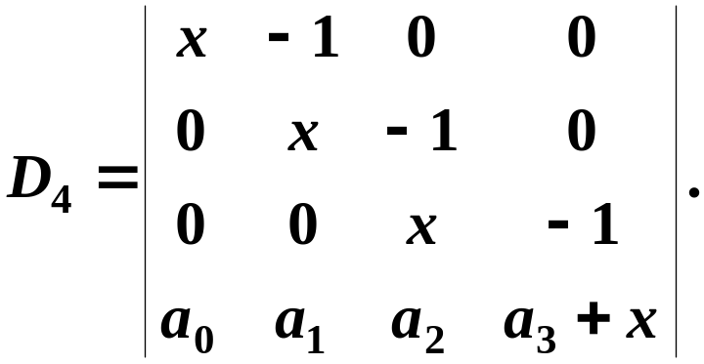
㖎㐃㩝㞁㩗
4. 㧞 A 㪈㦘㜬㗉㱅㐂r ( A ) = 2，A X = b 㭼㦘㙀㝀 X₁ , X₂ , X₃ ，
㤆㯣 X₁ = ( 2 , 3 , 1 )^{T}, X₂ + X₃ = ( 3 , 5 , 2 )^{T} , 㯱㗉㓌㰥 A X = b
㔻㩕㝀㪈
㐆
5. 㥧㖎㓄㬧
䍤
䈻
㺖
㰓㔩㐂㯱 t 㠝㱣 㐆
㦘㐃㜘㧒㚗㞸㦺
䍤
䈻
㺖

Slide 4
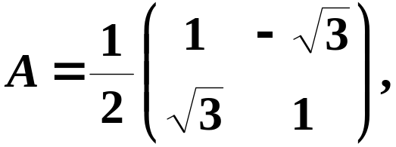


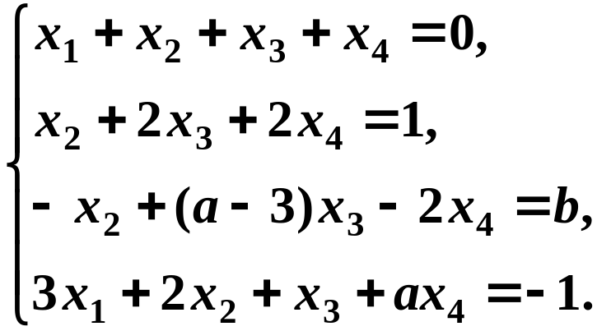
㦰㐃㧞
㭬㰝
㤴
㪊㐃㧞㫫㫝㗉㓌㰥
䍤
䈻
㺖
(1) 㔳 a , b 㪈㙹㯫㧀㐂㗉㓌㰥㭼㪢㭎㝀㐄
(2) 㔳 a , b 㪈㙹㯫㧀㐂㗉㓌㰥㪒㝀㐄
(3) 㔳 a , b 㪈㙹㯫㧀㐂㗉㓌㰥㭼㪒㤲㔥㙀㝀㐂㑑㤴㤆㝀㐆
䍤
䈻
㺖

Slide 5
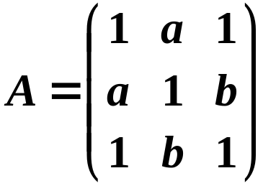
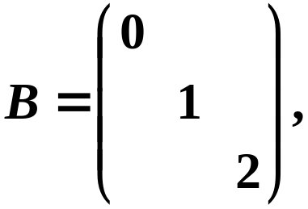
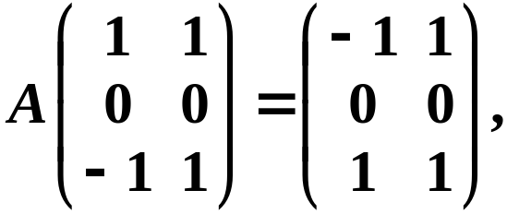





㟰㐃㧞
㫩㦠㮺
㤴 a , b 㐆
㤀㐃㧞 A 㪈㦘㜬㦴㔫㓊㝊㱅㐂
㤴 A 㔻㩛㱩㯫㭐㩛㱩㫗㟜㐂㑑㤴 A㐆
䍤
䈻
㺖
㑯㐃㛜
㮀㰓㛆㑍㚟㚁㪈㑙㱟㬥㐆
㝄㐃㧞㫗㟜㰥
㫫㫝㪒㘔㐂㫗㟜
㝳㮂㱁㰥㫗㟜
㫫㫝㑣㧎㐂㖐㫗㟜 㐿㡦㮂㱁㰥㫗㟜㫫㫝㑣㧎㐂㰷㠗㐅
䍤
䈻
㺖
㫗㟜㰥
㐁 l 㪈㒺㨞㐇㫫㫝㪒㘔㐆

Slide 6
㫫㫝㕑㨞㧢㩗㐁㖎㐇 㝀㕅
㭎㐃㣃㔵㩗
1. 㧞
㯱 A 㰳㦸㭼㭎㙀 r −1 㜬㯽㦺㐿㪈㟬 .
( )
2. 㥧
㫫㫝㪒㘔㐂㯱
( )
3. 㥧 A 㝳㡨 , 㯱 ,
㤆㯣 㧂 A 㔻㑁㨜㝊㱅 .
( )
4. 㥧
㯱
㔻㱗㑓㪈 1 .
( )
䍤
䈻
㺖
5. 㧞 A, B, C 㪈 n 㜬㗉㱅㐂㥧 A B C = I㐂㯱
( )
6. 㧞 A 㪈 㝊㱅㐂r (A) = m㐂㯱㗛㤚㓄㫫㫝㗉㓌㰥
A X = b 㭎㔩㭼㝀 .
( )
䍤
䈻
㺖
7. 㥧 A, B 㪈 n 㜬㰓㔩㱅, 㯱
㭔㪈㰓㔩㱅 .
( )
8. 㥧 λ 㧂㰓㛆㝊㱅 A 㔻㩛㱩㯫㐂㯱 㭔㧂 A 㔻㩛㱩㯫 .
( )

Slide 7



㖎㐃㩝㞁㩗
1.
㐆
䍤
䈻
㺖
2. 㧞 㐂㯱
㐆
3. 㧞 , 㯱
㐆
䍤
䈻
㺖

Slide 8


㖎㐃㩝㞁㩗
4. 㧞 A 㪈㦘㜬㗉㱅㐂r ( A ) = 2，A X = b 㭼㦘㙀㝀 X₁ , X₂ , X₃ ，
㤆㯣 X₁ = ( 2 , 3 , 1 )^{T}, X₂ + X₃ = ( 3 , 5 , 2 )^{T} , 㯱㗉㓌㰥 A X = b
㔻㩕㝀㪈
㐆
5. 㥧㖎㓄㬧
䍤
䈻
㺖
㰓㔩㐂㯱 t 㠝㱣 㐆
䍤
䈻
㺖

Slide 9
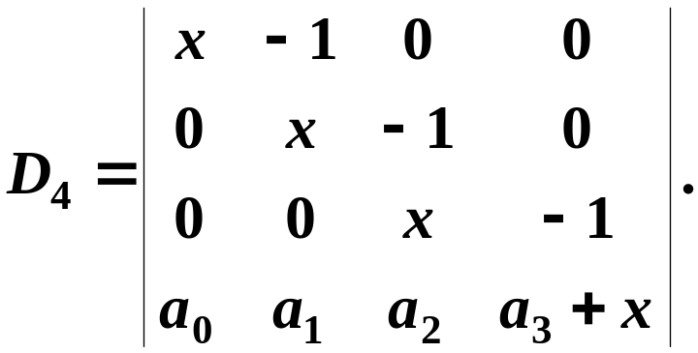
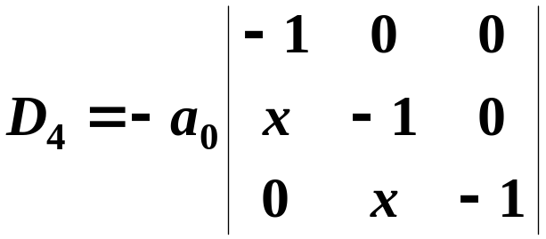
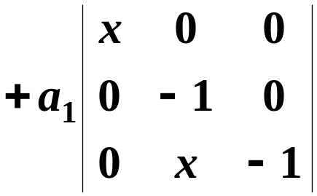
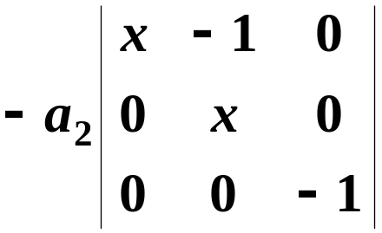
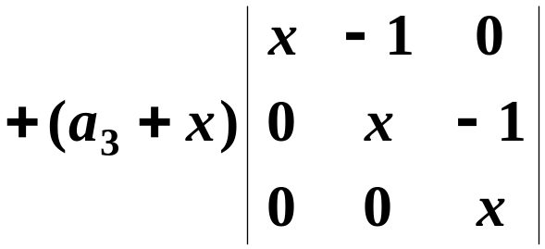

㦘㐃㜘㧒㚗㞸㦺
㝀䵶䵷䵸
㐖㰍㚇㭎㚗㱖㝷㐂
㜶㕛
䍤
䈻
㺖
䍤
䈻
㺖

Slide 10
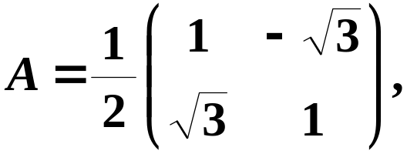


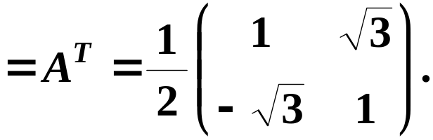

㦰㐃㧞
㭬㰝
㤴
㝀䵹䵺䵻
㮂㮺
㭨㓆㝊㱅 A 㝳㡨㐂
㤂
㭢㮂㮺 A 㪈㰓㛆㝊㱅㐂
㙐
㜶㕛
䍤
䈻
㺖
䍤
䈻
㺖

Slide 11
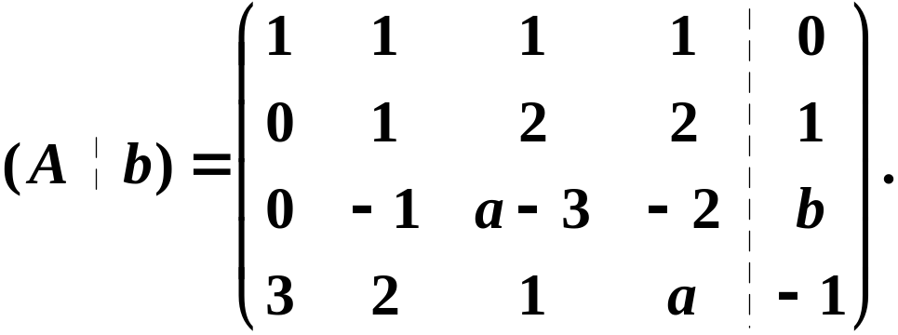
㪊㐃㧞㫫㫝㗉㓌㰥
(1) 㔳 a , b 㪈㙹㯫㧀㐂㗉㓌㰥㭼㪢㭎㝀㐄
(2) 㔳 a , b 㪈㙹㯫㧀㐂㗉㓌㰥㪒㝀㐄
䍤
䈻
㺖
(3) 㔳 a , b 㪈㙹㯫㧀㐂㗉㓌㰥㭼㪒㤲㔥㙀㝀㐂㑑㤴㤆㝀㐆
㤆㯻㘜㝊㱅㪈㐅
㝀䶲䶳䶴
䍤
䈻
㺖

Slide 12
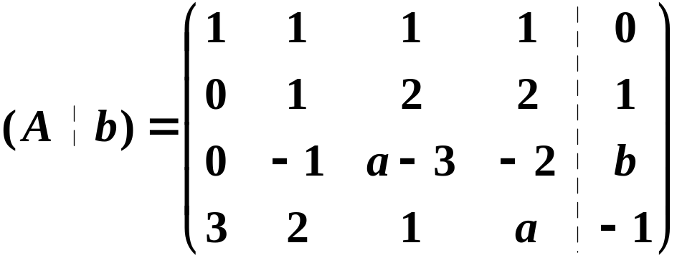
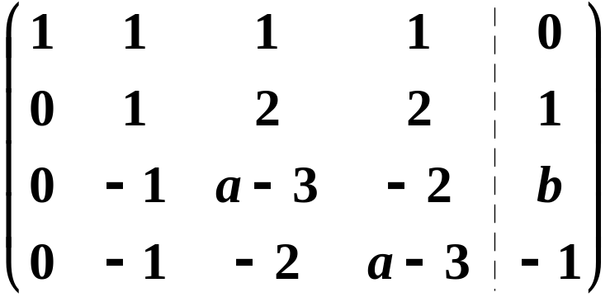

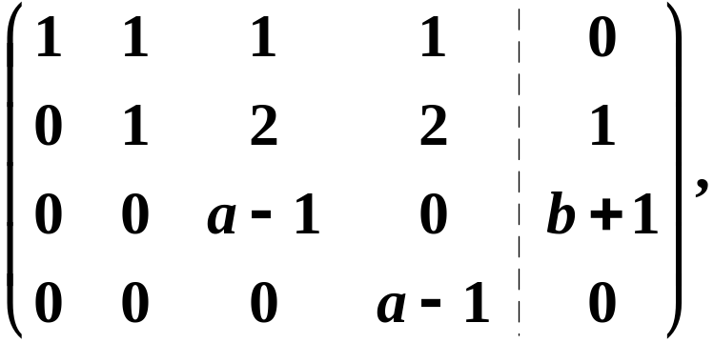
㤆㯻㘜㝊㱅㪈㐅
㝀䶬䶭䶮
䍤
䈻
㺖
䍤
䈻
㺖

Slide 13



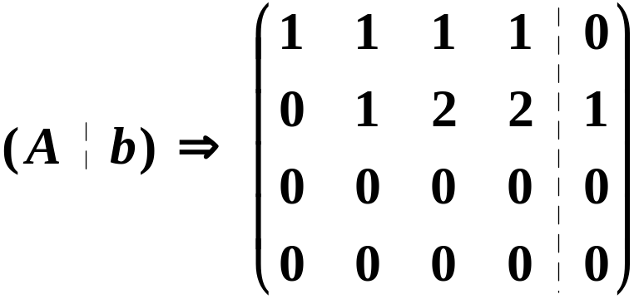
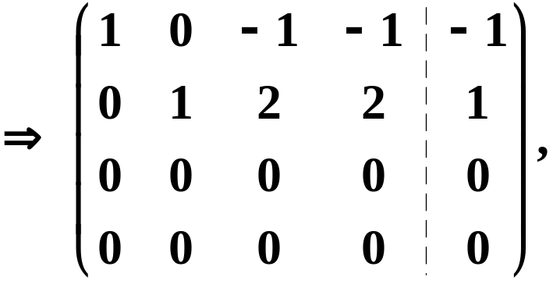
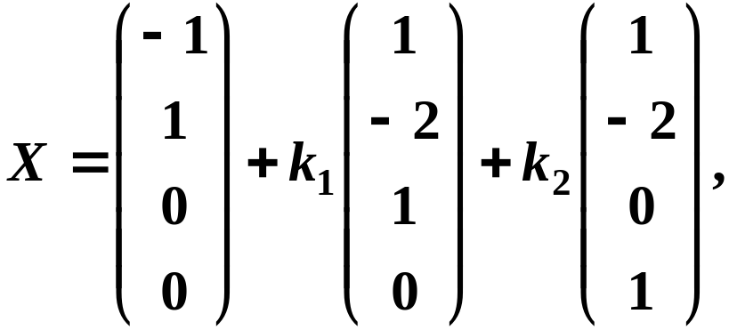

㝀䶦䶧䶨
(1) 㔳 㧀㐂
㗉㓌㰥㭼㪢㭎㝀㐄
(2) 㔳 㧀㐂㗉㓌㰥㪒㝀㐄
(3) 㔳 㧀㐂㗉㓌㰥㭼㪒㤲㔥㙀㝀㐂
㓆㧀㐂
䍤
䈻
㺖
㜶㕛㫫㫝㗉㓌㰥㔻㝀㪈
䍤
䈻
㺖
㤆㯣 㪈㥷㭶㒺㨞㐆

Slide 14
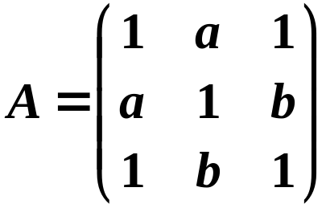
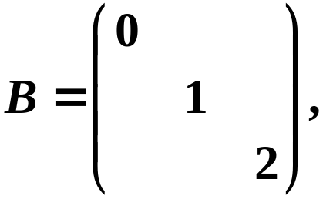
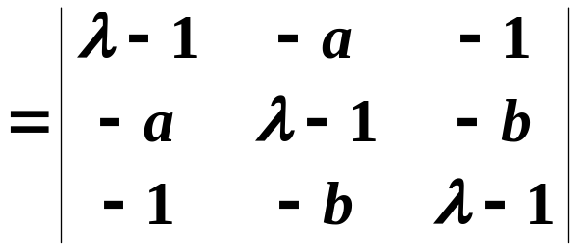





㟰㐃㧞
㫩㦠㮺
㤴 a , b 㐆
㝀䵪䵫䵬
㝊㱅 A 㔻㩛㱩㔥㬁㦺㪈㐅
䍤
䈻
㺖
㮂㮺㫩㦠㝊㱅㭼㫩㩃㔻㩛㱩㯫㐂
㭨㓆㭼
䍤
䈻
㺖

Slide 15
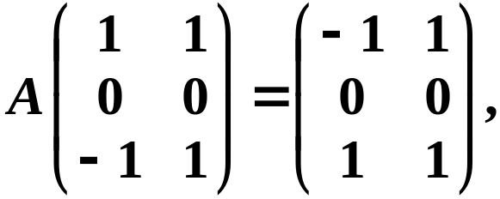













㤀㐃㧞 A 㪈㦘㜬㦴㔫㓊㝊㱅㐂
㤴 A 㔻㩛㱩㯫㭐㩛㱩㫗㟜㐂㑑㤴 A㐆
(1) 㞴
㯱㭼
㝀䵪䵫䵬
㜶㕛 A 㔻㟦㙀㩛㱩㯫㖻㒁㪈 㚋
䍤
䈻
㺖
㭢㮂㮺 㐂
㙐 A 㔻㞺㭎㙀㩛㱩㯫㪈
㤂㮂㓆㝳㰝㐂A 㔻 3 㙀㩛㱩㯫㛚㪈㔣㘤㐆
(2) 㔳 㧀㐂
㔫㭮㔻㩛㱩㫗㟜㪈
䍤
䈻
㺖
㔳 㧀㐂
㔫㭮㔻㩛㱩㫗㟜㪈

Slide 16








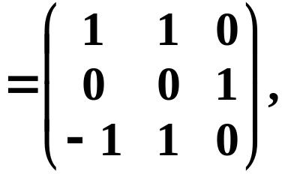
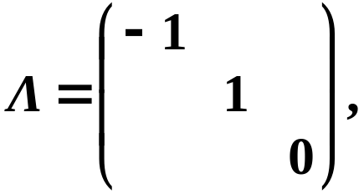

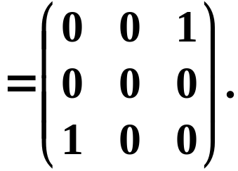







㤀㐃㧞 A 㪈㦘㜬㦴㔫㓊㝊㱅㐂
㤴 A 㔻㩛㱩㯫㭐㩛㱩㫗㟜㐂㑑㤴 A㐆
(3) 㔳 㧀㐂
㝀䶎䶏䶐
㧞㤆㔫㭮㔻㩛㱩㫗㟜㪈
㮂㮺 A 㪈㦴㔫㓊㝊㱅㐂
㙐 㭐 㚋 㛚㰓㛆㐂
㮂㓆㝳㕛
㤆㯣
䍤
䈻
㺖
(4) 㞴
䍤
䈻
㺖
㯱㭼

Slide 17
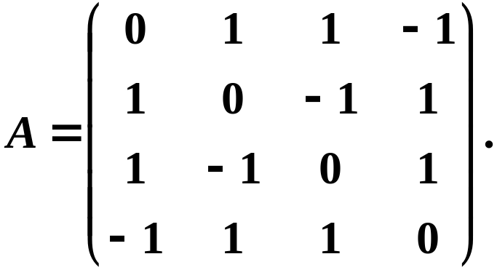







㑯㐃㛜
㮀㰓㛆㑍㚟㚁㪈㑙㱟㬥㐆
㝀䵹䵺䵻
㘰㖎㓄㬧㦼㔫㭮㔻㝊㱅㪈
(1) 㞴
䍤
䈻
㺖
㝳㕛㔟 A 㔻㩛㱩㯫㪈
㐁㦘㓖㘤㐇
㐁㔣㘤㐇
(2) 㔳 㧀㐂
㤴㕛 A 㔻㦘㙀㫫㫝㪒㘔㔻㩛㱩㫗㟜㪈㐅
䍤
䈻
㺖

Slide 18

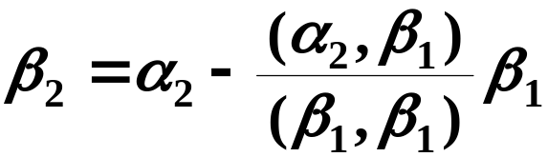
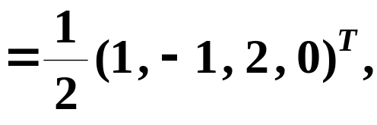
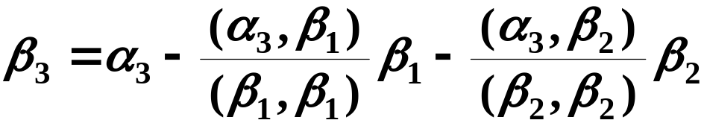
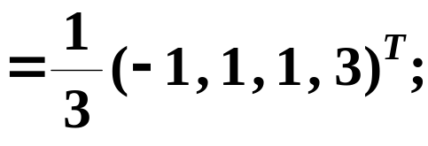
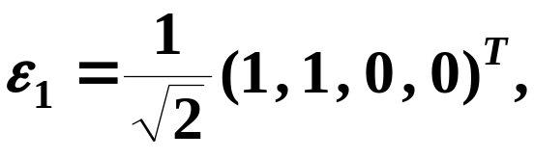
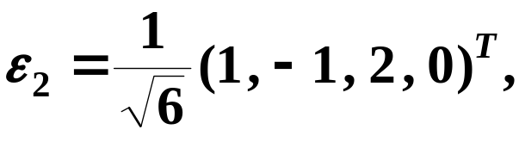
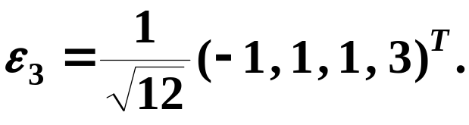
㝀䶅䶆䶇
(2) 㔳 㧀㐂
㰓㛆㚁㐅
䍤
䈻
㺖
㔣㪌㚁㐅
䍤
䈻
㺖

Slide 19


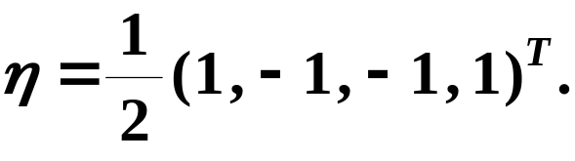
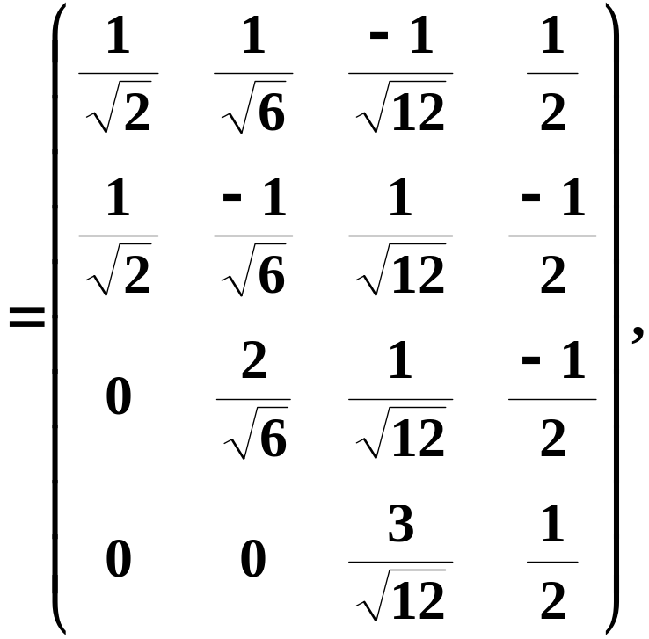




㝀䶈䶉䶊
㤴㕛 A 㔻㭎㙀㫫㫝㪒㘔㔻㩛㱩㫗㟜㪈㐅
(3) 㔳 㧀㐂
㔣㪌㚁㐅
䍤
䈻
㺖
(4) 㞴
䍤
䈻
㺖
㯱

Slide 20


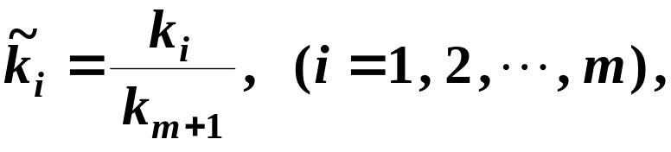
㝄㐃㧞㫗㟜㰥
㫫㫝㪒㘔㐂㫗㟜
㝳㮂㱁㰥㫗㟜
㫫㫝㑣㧎㐂㖐㫗㟜 㐿㡦㮂㱁㰥㫗㟜㫫㫝㑣㧎㐂㰷㠗㐅
㫗㟜㰥
㐁 l 㪈㒺㨞㐇㫫㫝㪒㘔㐆
㰷㠗䶢䶣
㞴
(1) 㥟㘢
㛜㦚㦺㟦㑥㓜㭖 㐂
㜶㕛
䍤
䈻
㺖
㤆㯣㐂
䍤
䈻
㺖

Slide 21





㝄㐃㧞㫗㟜㰥
㫫㫝㪒㘔㐂㫗㟜
㝳㮂㱁㰥㫗㟜
㫫㫝㑣㧎㐂㖐㫗㟜 㐿㡦㮂㱁㰥㫗㟜㫫㫝㑣㧎㐂㰷㠗㐅
㫗㟜㰥
㐁 l 㪈㒺㨞㐇㫫㫝㪒㘔㐆
㰷㠗䶢䶣
㞴
(2)
㮂㫗㟜 㝳㮂 㫫㫝㑣㧎㐂
㝳㕛
䍤
䈻
㺖
㫗㟜 㭔㝳㮂 㫫㫝㑣㧎㐂
㱁㭐㩗㧞㠣㔽㐂
㙐
(1) 如果
(3) 㮂 㫫㫝㪒㘔㐂
㭼
䍤
䈻
㺖
㜶㕛 㫫㫝㪒㘔㐆

Slide 22

䍤
䈻
㺖
䍤
䈻
㺖
……
放松一下吧 !

